Slide 1

CISC 250 – Business Telecomm Networks
Mobile Data Networks

Slide 2
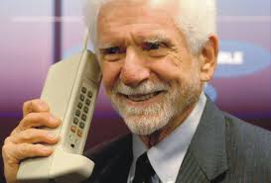

History of Mobile Data Networks
Remember that phones were originally designed for calls

Slide 3
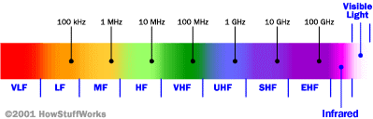
Cellular Network Basics
There are many types of cellular services; before delving into details, focus on basics (helps navigate the “acronym soup”)
Cellular network/telephony is a radio-based technology; radio waves are electromagnetic waves that antennas propagate
Most signals are in the 850 MHz, 900 MHz, 1800 MHz, and 1900 MHz frequency bands
Cell phones operate in this frequency range (note the logarithmic scale)

Slide 4
Structure of Cellular Network
A network of radio base stations forming the base station subsystem.
The core circuit switched network for handling voice calls and text
A packet switched network for handling mobile data
The public switched telephone network (PSTN) to connect subscribers to the wider telephony network

Slide 5
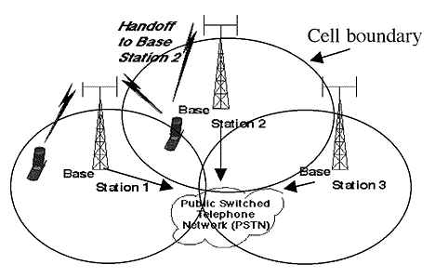
Cellular Network
Base stations transmit to and receive from mobiles at the assigned spectrum
Multiple base stations use the same spectrum (spectral reuse)
The service area of each base station is called a cell
Each mobile terminal is typically served by the ‘closest’ base stations
Handoff when
terminals move

Slide 6
The Multiple Access Problem
The base stations need to serve many mobile terminals at the same time (both downlink and uplink)
All mobiles in the cell need to transmit to the base station
Interference among different senders and receivers
So we need multiple access scheme

Slide 7
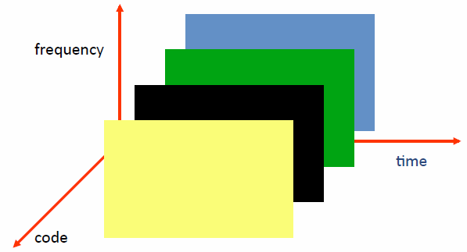
Multiple Access Schemes
3 orthogonal Schemes:
Frequency Division Multiple Access (FDMA)
Time Division Multiple Access (TDMA)
Code Division Multiple Access (CDMA)

Slide 8
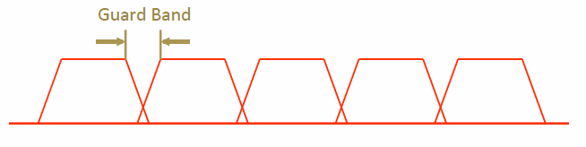
Frequency Division Multiple Access
frequency
Each mobile is assigned a separate frequency channel for a call
Guard band is required to prevent adjacent channel interference
Usually, one downlink band and one uplink band
Different cellular network protocols use different frequencies
Frequency is precious and scare – we are running out of it
Cognitive radio

Slide 9
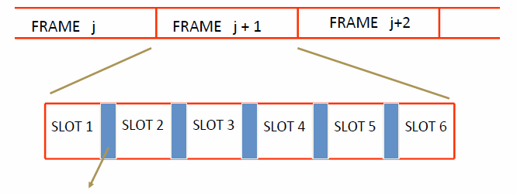
Time Division Multiple Access
Guard time – signal transmitted by mobile terminals at different locations do no arrive at the base station at the same time
Time is divided into slots and only one mobile terminal transmits during each slot
Like during the lecture, only one can talk, but others may take the floor in turn
Each user is given a specific slot. No competition in cellular network
Unlike Carrier Sensing Multiple Access (CSMA) in WiFi

Slide 10
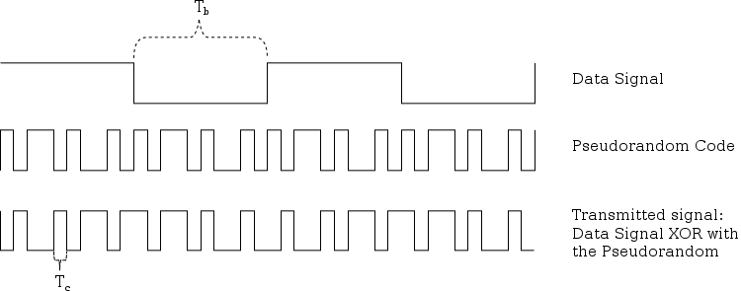
Code Division Multiple Access
Use of orthogonal codes to separate different transmissions
Each symbol of bit is transmitted as a larger number of bits using the user specific code – Spreading
Bandwidth occupied by the signal is much larger than the information transmission rate
But all users use the same frequency band together
Orthogonal among users

Slide 11

Mobile Phone Evolution
1st Generation (1G)
AMPS
2nd Generation (2G)
GSM, IS-95 (cdmaOne)
3rd Generation (3G)
UMTS (WCDMA), CDMA2000
4th Generation (4G)
LTE-A
Notes:
http://www.pcmag.com/article2/0,2817,2407896,00.asp
CDMA family
Sprint, Verizon
No sim card
Voice and Data: Not at the same time
GSM family
AT&T, T Mobile
Sim card
Voice and Data: can use at the same time
4G LTE standard
Use SIM card

Slide 12
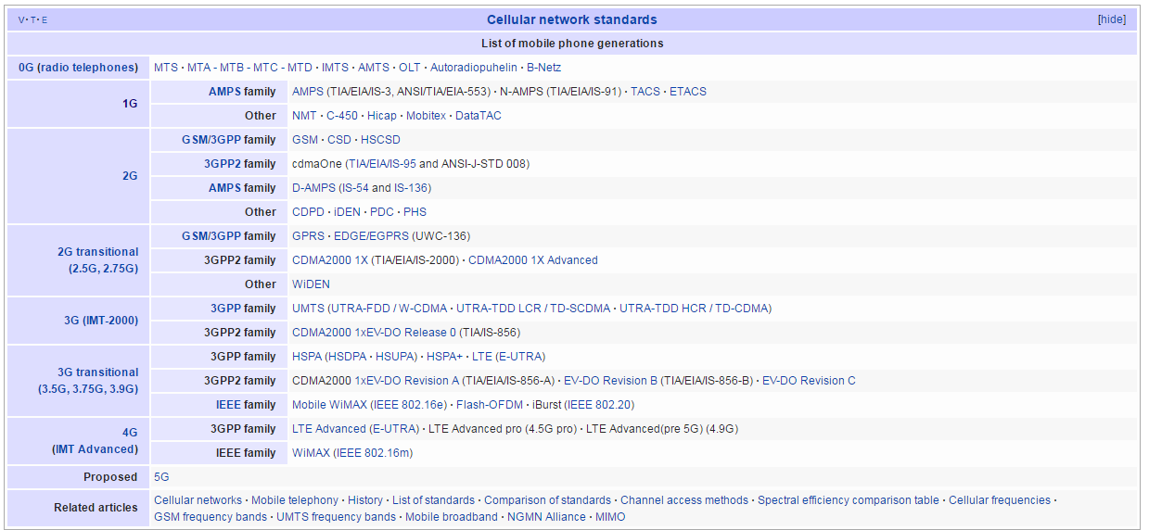
Mobile Phone Generations
Notes:
Source: Wikipedia,
https://en.wikipedia.org/wiki/List_of_mobile_phone_generations

Slide 13
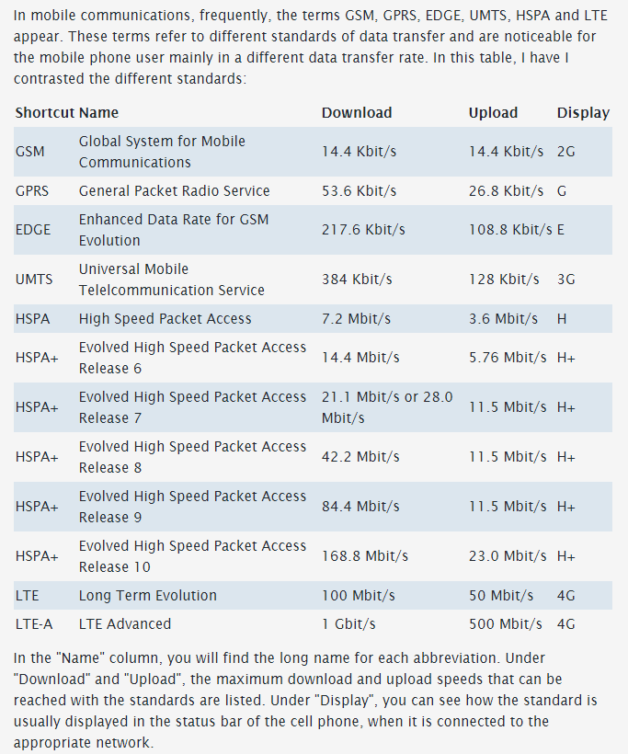
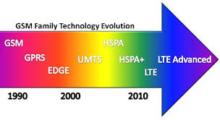
Mobile Phone Generations (2)
Information Source:
Mobile Communication: What are GSM, GPRS, EDGE, UMTS, HSPA and LTE?
http://www.askingbox.com/info/mobile-communication-what-are-gsm-gprs-edge-umts-hspa-and-lte
Image Source: www.deadzones.com

Slide 14
1G - AMPS
Advanced Mobile Phone System (AMPS)
1st Generation (1G) mobile cellular phone
Analog standard using FDMA (Frequency Division Multiple Access)
Developed by Bell Labs
Introduced in North America in Oct. 1983

Slide 15
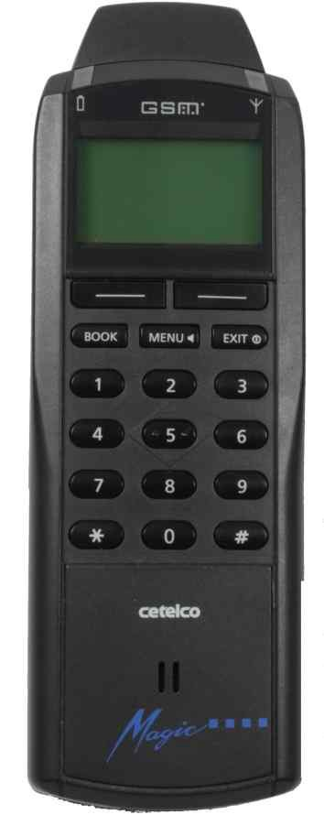


2G - GSM
GSM
Global System for Mobile Communications (GSM)
2nd Generation (2G) mobile cellular phone: Digital system
Introduced in Finland in 1991
Dominant global standard
Over 90% market share
Operated in over 219 countries & territories
GSM uses TDMA & FDMA combined
GSM supports voice calls and data transfer speeds up to 9.6 kbps, and SMS (Short Message Service)

Slide 16
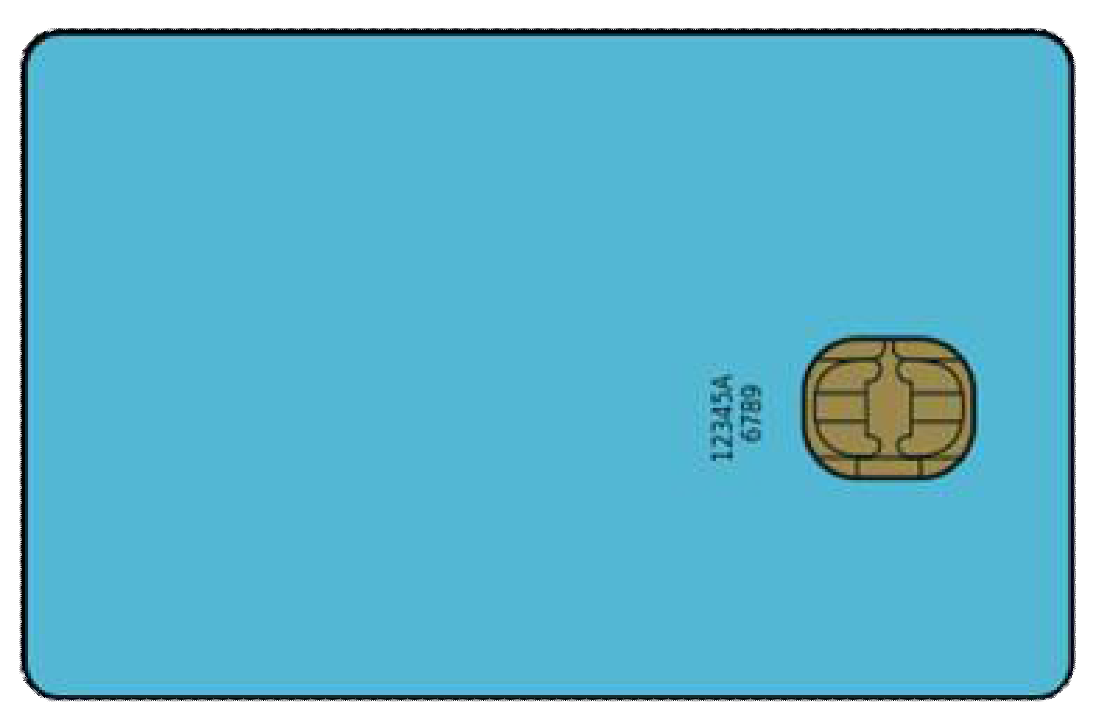
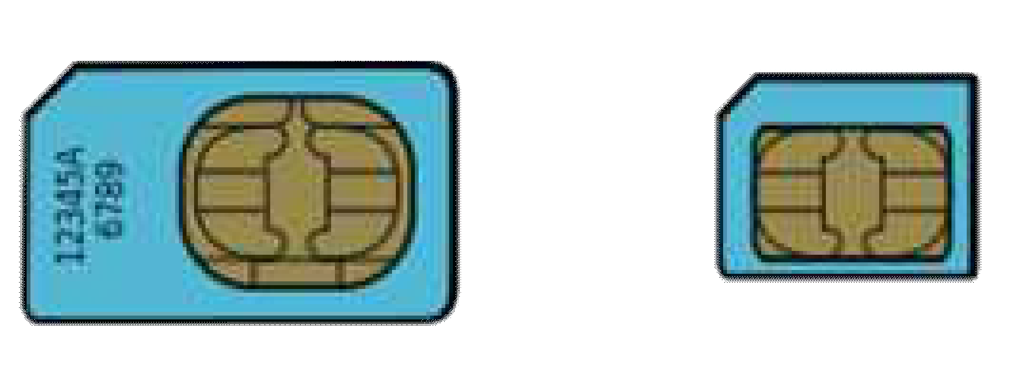
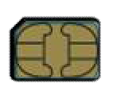
2G - GSM
SIM (Subscriber Identity Module)
SIM is a detachable smart card
SIM contains user subscription information and phone book
SIM Advantages
SIM enables a user to maintain user information even after switching cellular phones
Or, by changing ones SIM a user can change cellular phone operators while using the same the mobile phone

Slide 17
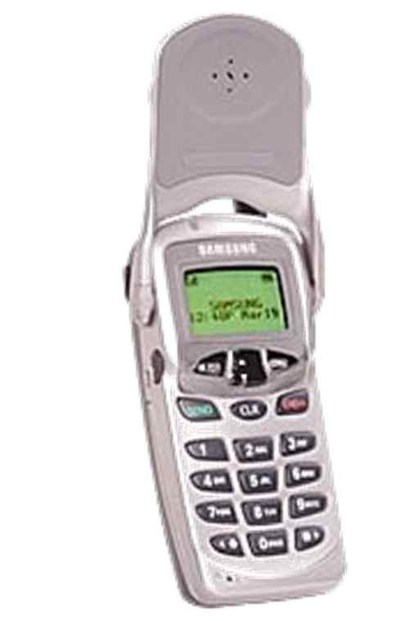



2G - IS-95: cdmaOne
IS-95
IS-95 (Interim Standard 95) is the first CDMA based 2G digital cellular standard
Why CDMA?
CDMA performs well against (narrow band) interference and (multipath) signal fading
cdmaOne is the brand name for IS-95 that was developed by Qualcomm
Hutchison launched the first commercial cdmaOne network in Hong Kong in September 1995
IS-95 traffic channels support voice or data at bit rates of up to 14.4 kbps

Slide 18
2.5G – GPRS/EDGE
GPRS
General Packet Radio Service (GPRS)
Packet Switching for data service
Evolved from GSM
support voice or data at bit rates of up to 85.6 kbps
EDGE
Enhanced Data Rates for GSM Evolution (EDGE)
8PSK encoding for improved data transmission
Evolved from GPRS
support voice or data at bit rates of up to 236.8 kbps

Slide 19
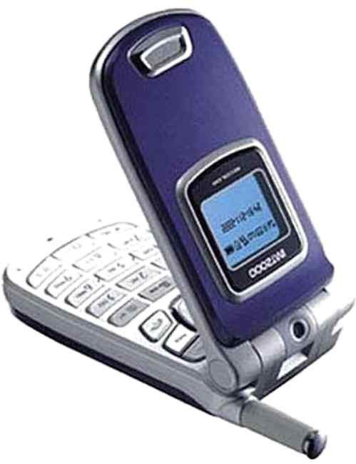
3G - UMTS
Universal Mobile Telecommunications System (UMTS)
3rd Generation (3G) mobile cellular system
Evolution of GSM
UTRA (UMTS Terrestrial Radio Access) supports several different terrestrial air interfaces
Multiuser Access in UTRA can be supported by UTRA-FDD or UTRA-TDD
FDD (Frequency Division Duplex)
TDD (Time Division Duplex)

Slide 20
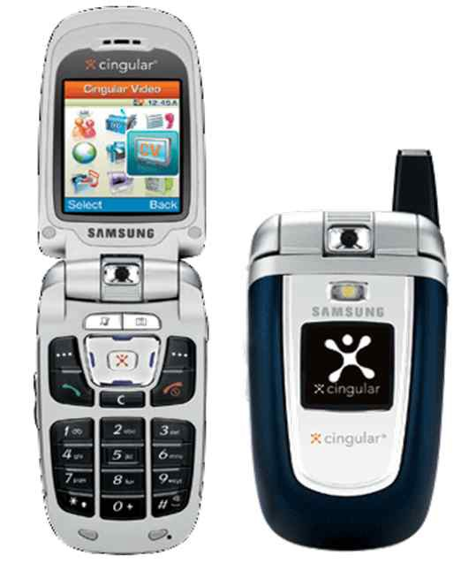
3G - UMTS: WCDMA
WCDMA (Wideband Code Division Multiple Access)
3rd Generation (3G) mobile cellular system that uses the UTRA-FDD mode
3GPP (3rd Generation Partnership Project) Release 99
Up to 2 Mbps data rate
First commercial network opened in Japan is 2001
Seamless mobility for voice and packet data applications
QoS (Quality of Service) differentiation for high efficiency of service delivery
Simultaneous voice and data support
Interworks with existing GSM networks

Slide 21
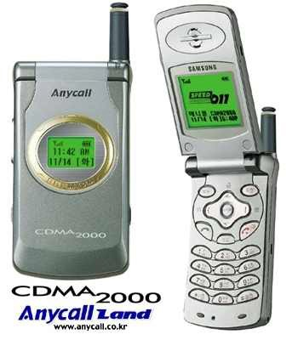
3G - CDMA2000
CDMA2000
3G mobile cellular system
Standardized by 3GPP2
Evolution of IS-95 cdmaOne standards
Uses CDMA & TDMA
CDMA (Code Division Multiple Access)
TDMA (Time Division Multiple Access)
Initially used in North America and South Korea (Republic of Korea)
CDMA2000 1xEV-DO (Evolution-Data Optimized) enables 2.4 Mbps data rate
Regarded as the first 3G system based on ITU standards
Notes:
3GPP2: 3rd Generation Partnership Project 2

Slide 22
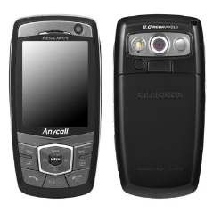
3.5G - HSDPA
High-Speed Downlink Packet Access (HSDPA)
Enhanced 3G mobile communications protocol
Evolution of UMTS for higher data speeds and capacity
Belongs to the HSPA (High-Speed Packet Access) family of protocols
HSDPA commercial networks became available in 2005
Peak Data Rate
Downlink: 14 Mbps (Release 5)

Slide 23
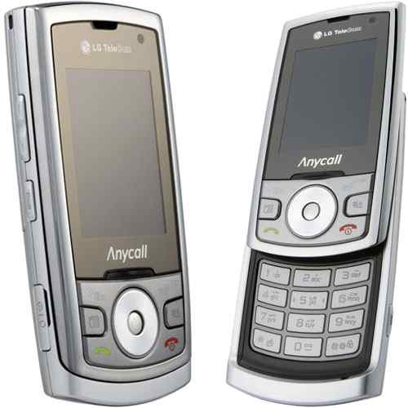
3.5 G - EV-DO Rev. A
EV-DO Rev. A (Revision A)
Peak Data Rate
Downlink: 3.1 Mbps
Uplink: 1.8 Mbps
Launched in the USA on October 2006
VoIP support based on low latency and low bit rate communications
Multi-User Packet technology enables the ability for more than one user to share the same timeslot
QoS (Quality of Service) flags included for QoS control

Slide 24
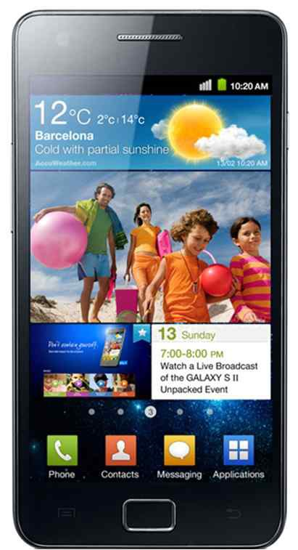
3.5 G - EV-DO Rev B
EV-DO Rev. B (Revision B)
EV-DO Rev. B was first deployed in Indonesia on January 2010
Multi-Carrier evolution of Rev. A
Higher data rates per carrier
Downlink Peak
4.9 Mbps per carrier
Uplink Peak
1.8 Mbps per carrier
More Efficient Asymmetric Data Rate Support
Downlink ≠ Uplink Data Rates
Asymmetric Service Examples
Web browsing
Multimedia content delivery

Slide 25
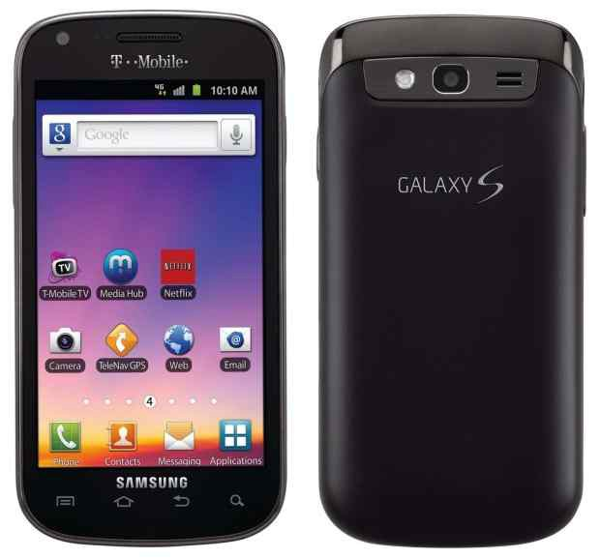
3.5G - HSPA+
Evolved High-Speed Packet Access (HSPA+)
HSPA+ all IP network first launched in Hong Kong in 2009
WCDMA (UMTS) based 3G enhancement
HSPA+ is a HSPA evolution
Peak Data Rate
Downlink: 168 Mbps
Uplink: 22 Mbps
Higher Date Rate Accomplished by
MIMO multiple-antenna technique
Higher order modulation (64QAM)
Dual-Cell HSDPA is used to combine multiple cells into one

Slide 26
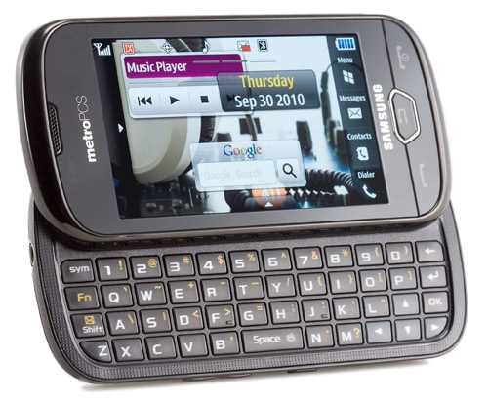
3.5G/4G - LTE
Long-Term Evolution (LTE)
LTE
LTE launched in North American on September 2010 with the Samsung SCH-R900
Deployed on both GSM and the CDMA mobile operators
Peak Data Rate (Release 8)
Downlink: 300 Mbps
Uplink: 75 Mbps

Slide 27
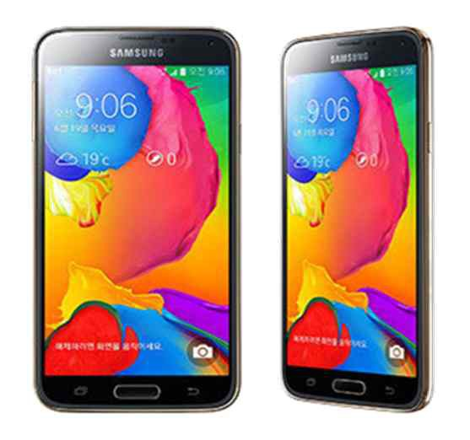
4G - LTE-A
LTE-A (LTE-Advanced)
Considered as a 4G technology based on the ITU-R IMT-Advanced process
Peak Data Rate (Release 10)
Downlink: 3 Gbps
Uplink: 1.5 Gbps
LTE-A incorporates higher order MIMO (4×4 and beyond) and allows multiple carriers to be bonded into a single stream

Slide 28
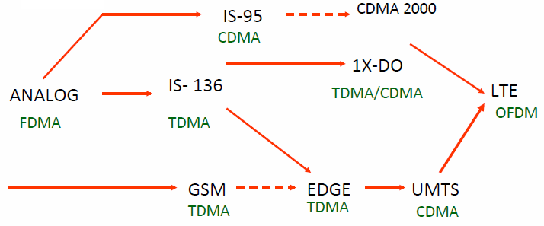
Evolution of Cellular Networks
1G
2G
2.5G
3G
4G

Slide 29
Service Roadmap
Improved performance, decreasing cost of delivery
3G-specific services take advantage of higher bandwidth and/or real-time QoS
Broadband
in wide area
Video sharing
Video telephony
Real-time IP
multimedia and games
Multicasting
A number of mobile services are bearer independent in nature
Multitasking
WEB browsing
Corporate data access
Streaming audio/video
MMS picture / video
xHTML browsing
Application downloading
E-mail
Voice & SMS
Presence/location
Push-to-talk
Typical average bit rates (peak rates higher)
GSM
9.6
kbps
GPRS
171
kbps
EGPRS
473
kbps
WCDMA
2
Mbps
HSDPA
1-10
Mbps
CDMA 2000 1x
CDMA 2000-EVDO
CDMA 2000-EVDV

Slide 30
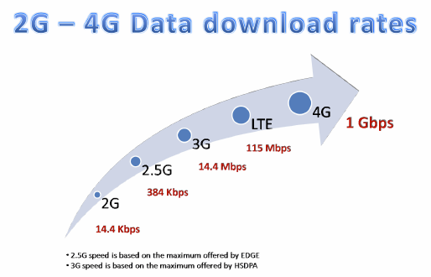
Comparison of Speed

Slide 31
5G - ?
Your final project?

Slide 32
Q & A

